Slide 1
Reinforcement Learning
Patryk Neubauer
Gradient Science Club 2022

Slide 2
Plan for Today
Fundamentals of Reinforcement Learning
Elements of RL - high level look
Theory behind learning
Dynamic Programming - Value/Policy Iteration
Model-free methods
Temporal-Difference Learning (SARSA, Q-learning)
Policy Gradient
Actor-Critic
Note on model-based approaches
Examples

Slide 3
Resources
A lot of hype -> a lot of good resources
MIT 6.S091: Introduction to Deep RL (Lex Fridman)
(Ongoing) HuggingFace Deep RL course
OpenAI Spinning Up
Deep Dive:
Reinforcement Learning: An Introduction (Sutton & Barto book)
RL Lecture Series (DeepMind x University College London)
Reinforcement Learning Specialization (University of Alberta)

Slide 4
Reinforcement Learning Background
Reinforcement Learning isn’t just machine learning
Neuroscience and psychology:
Studying learning and decision-making in animals and humans
Used to develop theories of addiction
Resemblance to dopamine
Study of strategic decision-making in Game Theory and Economics
Works on theory of Optimal Control from mathematics and Dynamic Programming

Slide 5
Fundamentals of Reinforcement Learning
Elements of RL - high level look

Slide 6
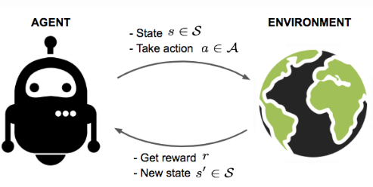
The RL Framework
Reinforcement Learning models every problem in this way.
An agent interacts with the environment through actions that he takes based on the state, for which he gains rewards.
Agents goal is to maximize the cumulative reward.
Sequence of (S_{n}, A_{n}, R_{n+1}, …, A_{t-1}, S_{t}, R_{t}) is called a trajectory.
Notes:
RL modeluje każdy problem w ten sposób
Mamy jakiegoś agenta i środowisko, agent ma jakiś stan, na podstawie którego podejmuje jakąś akcję.
Środowisko na podstawie tej akcji, daje za nią nagrodę i następny stan.
Celem agenta jest uzbieranie jak największej sumy nagród.
Widzimy że tak po kolei dostajemy stan, akcję, nagrodę, sekwencja takich trójek nazywa się trajektorią.

Slide 7
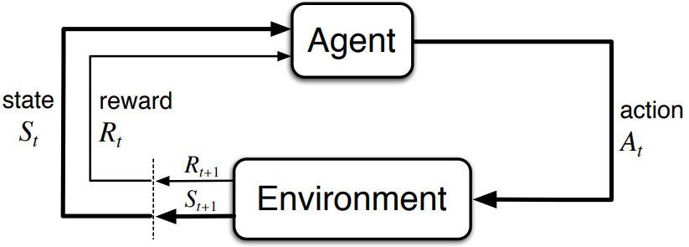
The RL Framework
At time step t:
St - current state of the environment
Rt - reward given by the environment for the previous action
At - action taken by the agent based on St 𝜋(a_{t} | s_{t}) (according to his policy)
St+1 and Rt+1 are the next state and reward given by the environment, affected by At P(S_{t+1} | S_{t}, A_{t}); R(S_{t}, A_{t})
𝜋(a_{t} | s_{t})
P(S_{t+1} | S_{t}, A_{t}); R(S_{t}, A_{t})
http://incompleteideas.net/book/RLbook2020.pdf
Notes:
Patrząc teraz na notację, przez S oznacza się stan, R nagrodę, A akcję.
t oznacza time-step, czyli t to będzie obecny, t+1 następny itd.
Dodatkowo decyzje agenta, są na podstawie policy - oznaczanej przez pi - są to prawdopodobieństwa podjęcia jakieś akcji w stanie
Środowiska ma w sobie 2 funkcje - prawdopodobieństwo przejścia do następnych stanów, przy poprzednim stanie i akcji i analogicznie dla nagrody.

Slide 8
The RL Framework
Alternative notation:
S_{t} = S
A_{t} = A
R_{t} = R
S_{t+1} = S’
R_{t+1} = R’
𝜋(a_{t} | s_{t})
P(S_{t+1} | S_{t}, A_{t}); R(S_{t}, A_{t})
http://incompleteideas.net/book/RLbook2020.pdf
Notes:
Tutaj taka alternatywna notacja, że zamiast tego t i t+1, obecne stan i nagroda to po prostu S i R, a następne to S prim i R prim

Slide 9
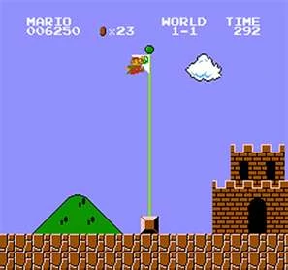
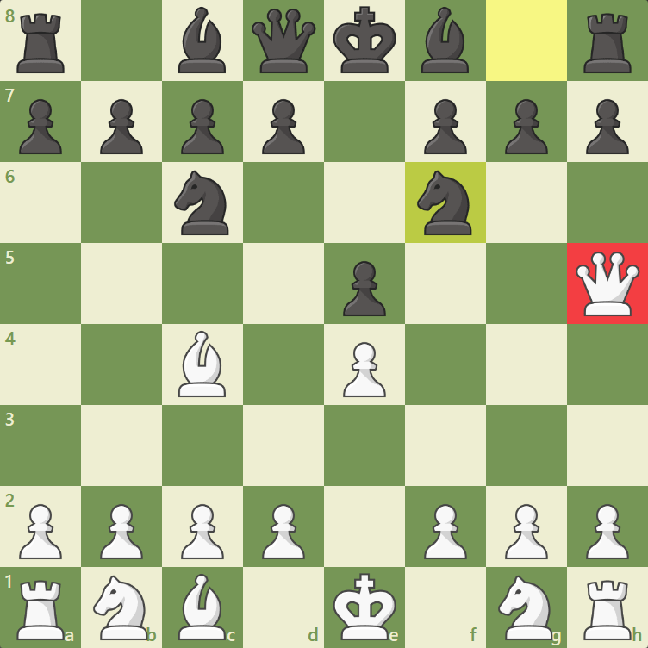
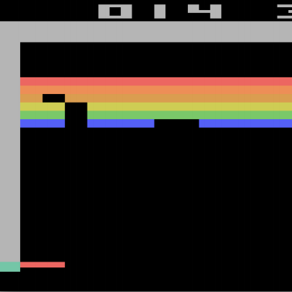
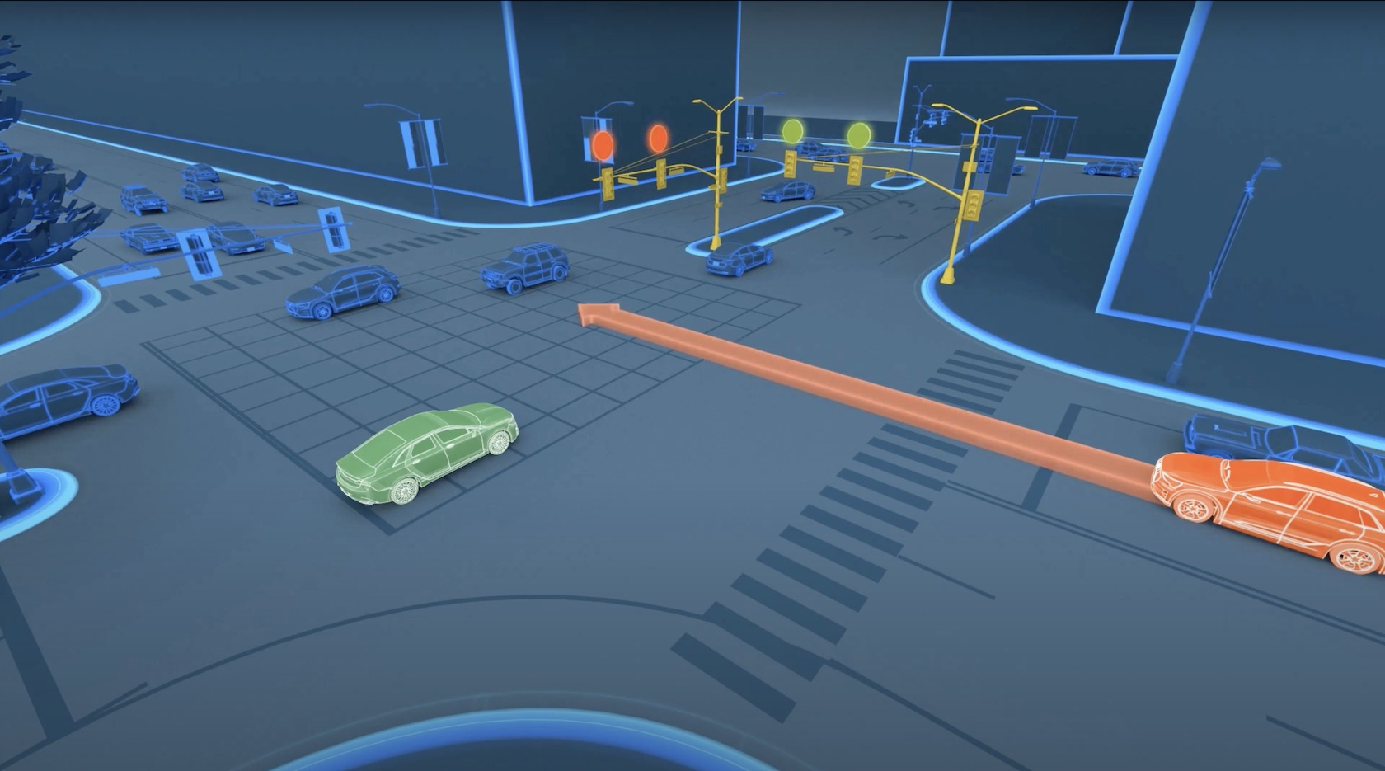

Type of tasks
Episodic - there’s an ending point - terminal state - after which an episode ends.
Continuous - tasks that continue forever - without a terminal state
Notes:
w RLu można wyróżnić 2 rodzaje zadań - epizodyczne i ciągłe
Epizodyczne mają jakiś stan końcowy - po którym epizod się kończy i zaczynamy następny na świeżo.
Najbardziej naturalnym przykładem są gry, gdzie w szachach mamy po prostu jedną partię, gra się kończy matem albo patem i tyle.
Zadania ciągłe, to takie które nie mają stanu końcowego - mogą iść w nieskończoność. Jako przykład to można dać np. kontrolę świateł na skrzyżowaniu, czy przewidywanie pogody.

Slide 10
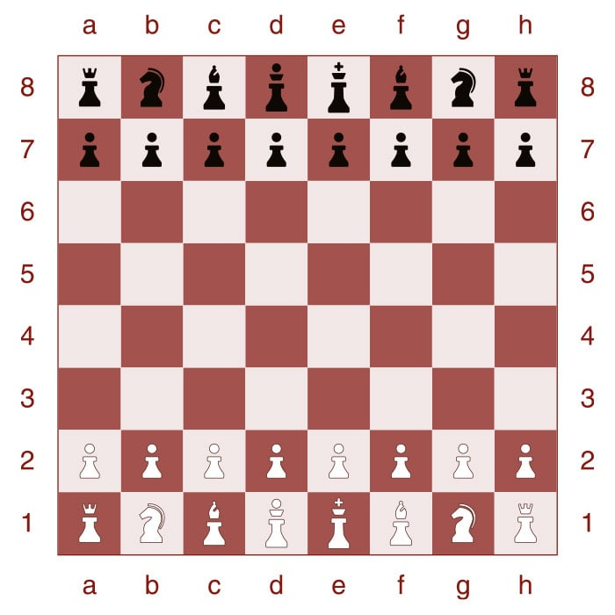
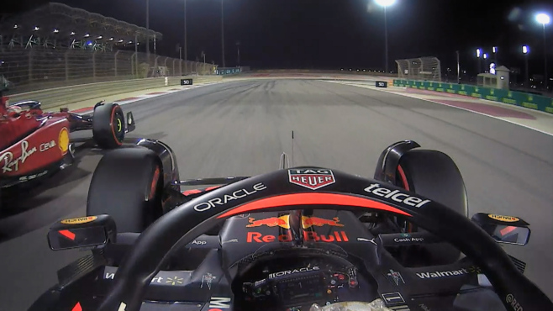
State Space
State - description of the environment - information available to the agent, based on which it needs to pick an action.
It can be basically anything:
Board state in a chess game
Screen of a video game
Camera feed from a robot
…
State represents the complete information about the environment (no hidden information), while observation is a partial description of the world - often used interchangeably
State - complete information
Observation - only some information is available
Notes:
Przestrzeń akcji - jest to informacja dostępna dla agenta na podstawie której wybiera on akcje.
Stanem może być w zasadzie wszystko, w zależności od tego co robimy, może to być stan gry, gdzie w szachach można podać po prostu jaka figura jest na jakim polu w tabeli, ale też obraz z gry czy kamera traktowane jak obrz.
Czasami się wyróżnia, że stan zawiera całkowitą informację o środowisku - czyli np. w szachach, gdzie możemy wszystko opisać.
Obserwacja to natomiast tylko częściowa obserwacja świata - np. w kartach nie wiemy co jest w stosie, co mają inny gracze. Z kamery to np. nie widzimy co jest za budynkiem

Slide 11
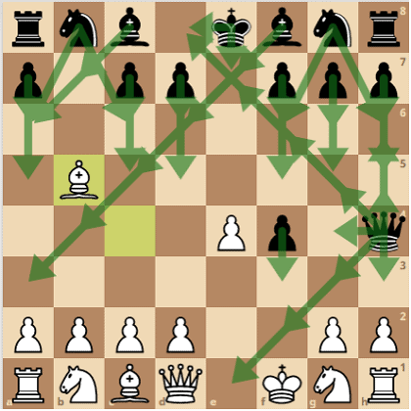
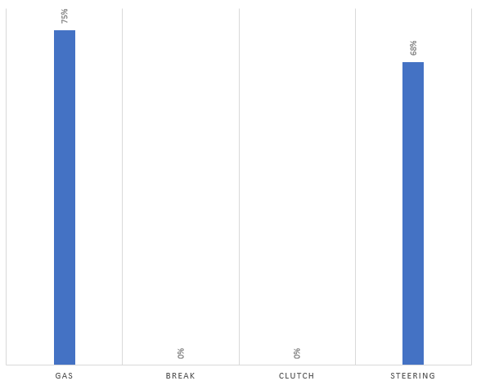
Action Space
Action Space / Actions are all of the possible things that agent can do in an environment
Like with state, it can be basically anything:
(Legal) chess moves
Keyboard/mouse/Gamepad inputs
Steering wheel/gas/break control
…
herculeschess.com
Notes:
No i analogicznie do stanów, mamy przestrzeń akcji, które są wszystkim co może wykonać agent.
W szachach byłaby to lista wszystkich możliwych ruchów, przy grach komputerowych mogą to być klawisze, w jeździe autonomicznej sterowanie gazem, hamulcem i kierownicą.

Slide 12
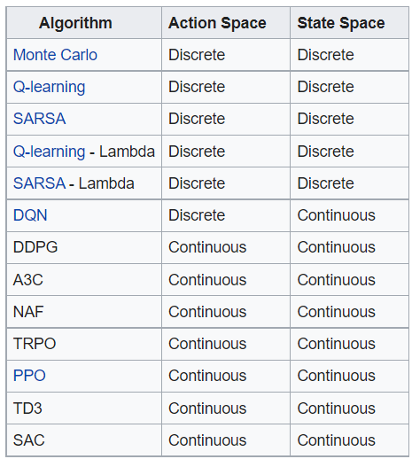
State/Action Space - Continuous vs. Discrete
Both state and action spaces can be either discrete or continuous.
If space is continuous (or discrete, but huge) we’re forced to use function approximators (e.g. neural networks) that approximate the value function/policy.
Action space being discrete or continuous, will determine which algorithms can be used
Examples:
Discrete state - Discrete actions -> Tic-Tac-Toe
Continuous state - Discrete actions -> Tetris
Discrete state - Continuous actions -> Blackjack
Continuous state - Continuous actions -> Driving

Slide 13
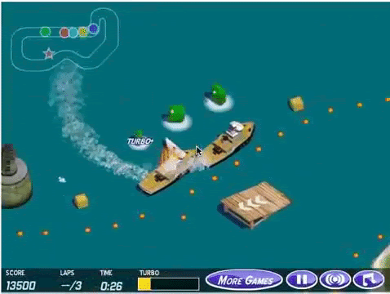
Rewards
Reward is the only feedback the agent gets, it tells whether the taken action was good or bad
Reward engineering is an important part of reinforcement learning in practice
Simplest approach can be the best e.g.
+1 for winning, -1 for losing in episodic games
+1 for each second a car stays on course
… but often it’s not that simple.
If the reward function is too easy or overengineered, it can be “hacked” and abused.
Sometimes it’s hard to say what the reward should even be:
Autonomous driving
Controlling a robot arm
…
DeepMind - Specification gaming: the flip side of AI ingenuity
Notes:
Nagrody,

Slide 14
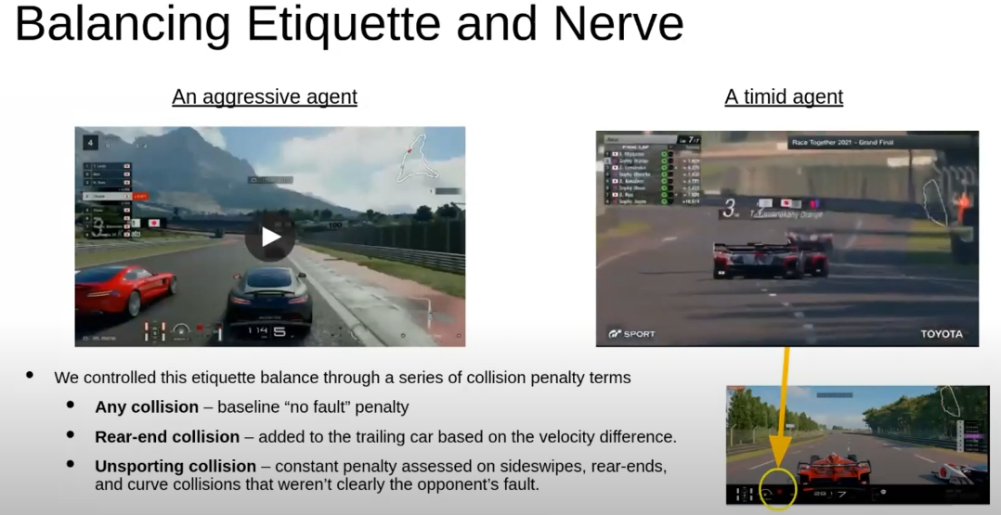
Rewards
Outracing Champion Gran Turismo Drivers with Deep Reinforcement Learning

Slide 15
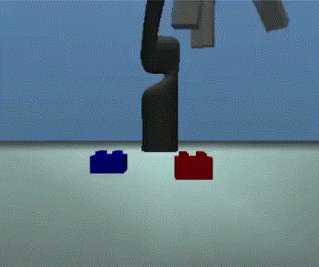
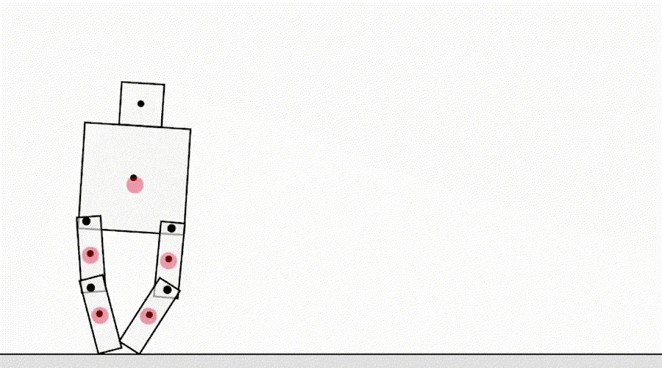
Rewards
DeepMind - Specification gaming: the flip side of AI ingenuity

Slide 16
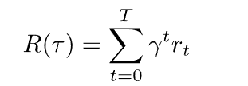
Rewards - returns
Return is the cumulative reward that an agents gets over a trajectory - either in an episode or an finite amount of time in a continuous task.
Discounted return is a variant of the return that takes into account the time value of reward.
Expected (discounted) return is the expected value of the return over all possible trajectories, taking into account the probability of each trajectory occurring.
,γ ∈ [0, 1]; if γ = 1 the return isn’t discounted
often also represented by G_{t}

Slide 17
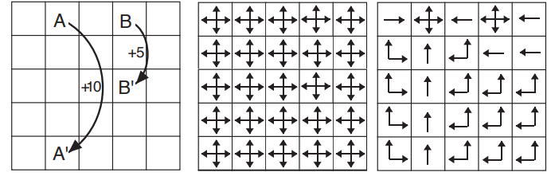
Policies
Policy is the function of agent’s behaviour - 𝜋(a_{t} | s_{t}).
It denotes the probability of action a_{t} in state s_{t.}
Can be stochastic or deterministic.
Optimal policy 𝜋* is a policy that maximizes expected return - learning it is the goal of RL.
Grid world example
Random policy
Optimal policy

Slide 18
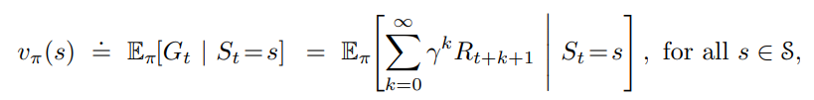
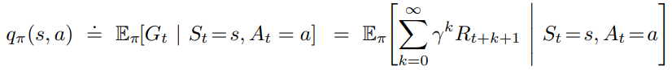
Value functions
State value functions are used to evaluate the quality of states. They represent the expected return that can be achieved by starting from a particular state and following a particular policy. The state value function is denoted as V(s), and it maps states to expected returns.
Action value functions are used to evaluate the quality of actions. They represent the expected return that can be achieved by taking a particular action in a particular state and following a particular policy. The action value function is denoted as Q(s, a), and it maps state-action pairs to expected returns.
V(s) = max_{a} Q(s,a)

Slide 19
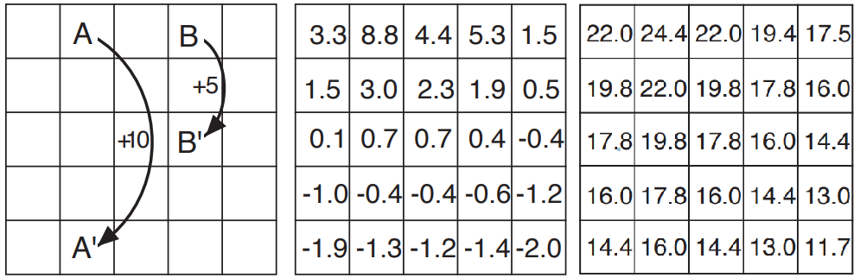
Value functions
For now we’ll assume that everything is in tabular form.
State values of a random policy.
State values of a optimal policy
*-1 for moving off the grid
Notes:
TODO: dodać że z Sutton książki

Slide 20
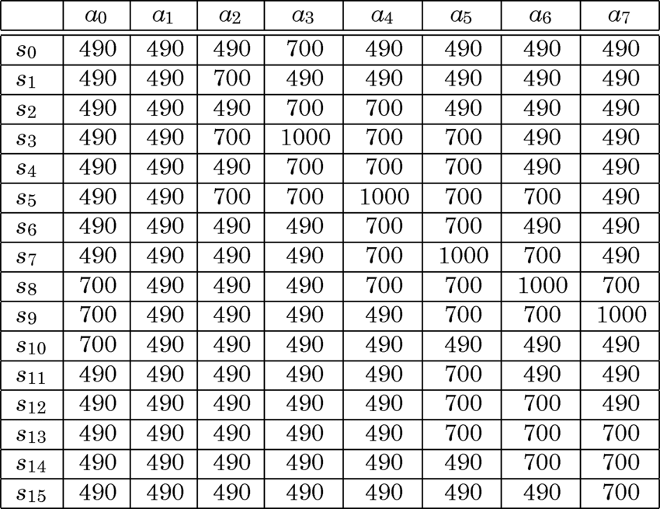
Value functions
For now we’ll assume that everything is in tabular form.
Gradient Descent Methods in Learning Classifier Systems: Improving XCS Performance in Multistep Problems.
Notes:
TODO: dodać że z Sutton książki

Slide 21
On Optimal Policies and Optimal Value Functions
To recap:
Policies define which actions agent should pick in different states.
Value functions represent the expected return under a policy of states / state-action pairs.
We can compare policies with value functions
𝜋 >= 𝜋’, if and only if v_{𝜋}(s) >= v_{𝜋’}(s) for all states
Optimal policies 𝜋* share the same optimal value functions v*(s) and q*(s,a)
Optimal policy 𝜋* can be determined by using value functions.

Slide 22
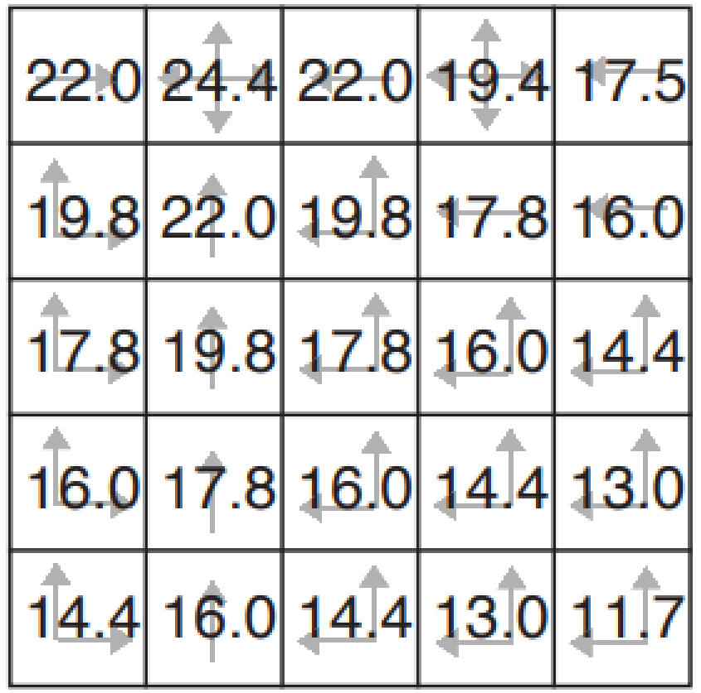
On Optimal Policies and Optimal Value Functions

Slide 23
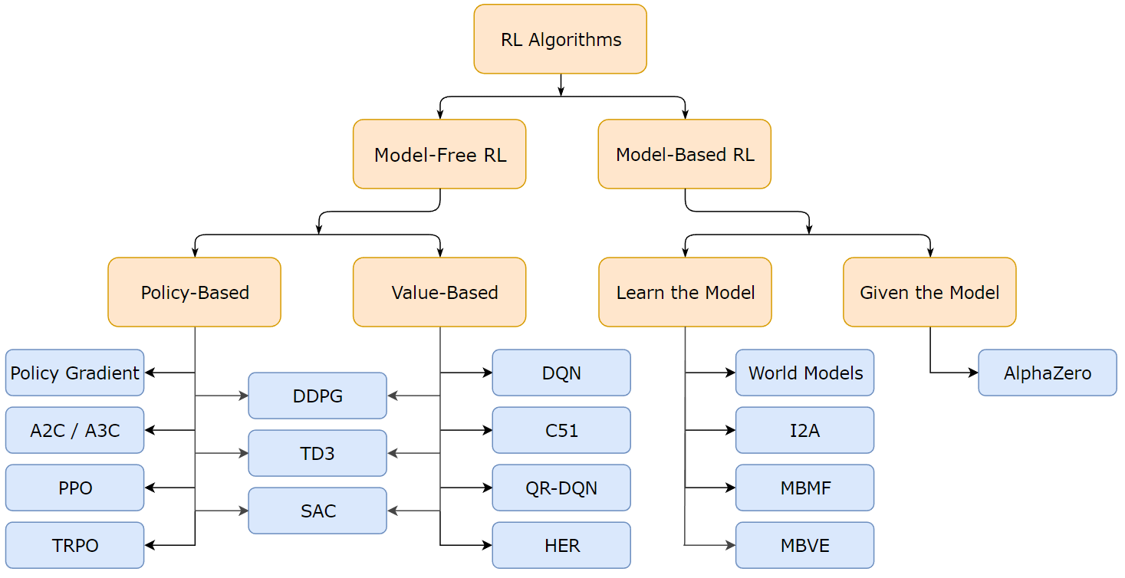
Taxonomy of Reinforcement Learning algorithms
OpenAI SpinningUp

Slide 24
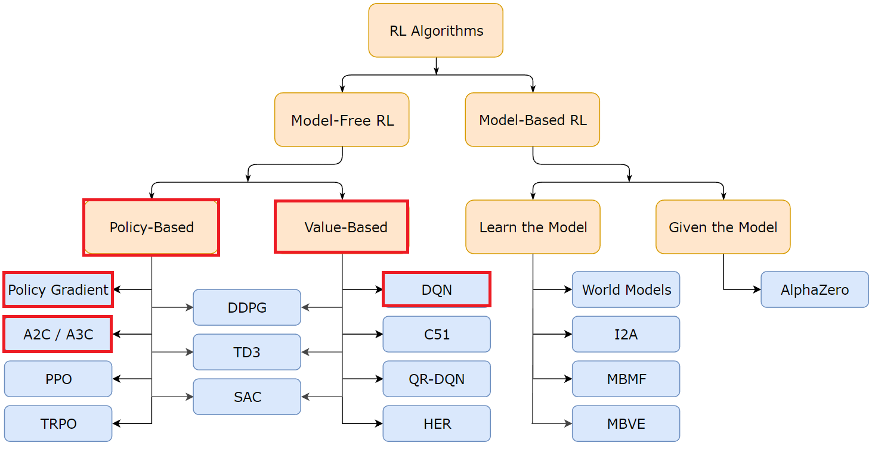
Taxonomy of Reinforcement Learning algorithms
OpenAI SpinningUp

Slide 25
Fundamentals of Reinforcement Learning
Theory behind learning - from math to playing atari.

Slide 26
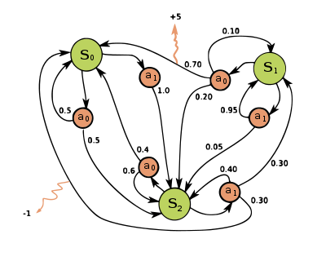
RL as Markov-Decision Process
Markov decision process (MDP) is a mathematical framework for modeling decision-making in situations where outcomes are partly random and partly under the control of a decision maker. An MDP consists of a set of states, a set of actions, and a reward function.
The goal in an MDP is to find an optimal policy.
https://en.wikipedia.org/wiki/Markov_decision_process

Slide 27
RL as Markov-Decision Process
The assumptions of MDPs:
The environment is fully observable: The agent has complete knowledge of the current state of the environment and can observe the probabilities of state transitions and rewards directly - model.
The environment is stationary: The transition probabilities and rewards do not change over time.
The environment is discrete: The set of states, actions, and rewards is finite and discrete.
The environment is Markovian: The future is independent of the past given the present, and the optimal policy depends only on the current state and not on the history of previous states.
Rarely the case in practice…

Slide 28
RL as Markov-Decision Process - Bellman equation
The Bellman equation is a fundamental equation in reinforcement learning that is used to solve MDPs.
It is used to calculate the value of a state or action, taking into account the expected value of the next state and the reward that is received for transitioning to that state.

Slide 29
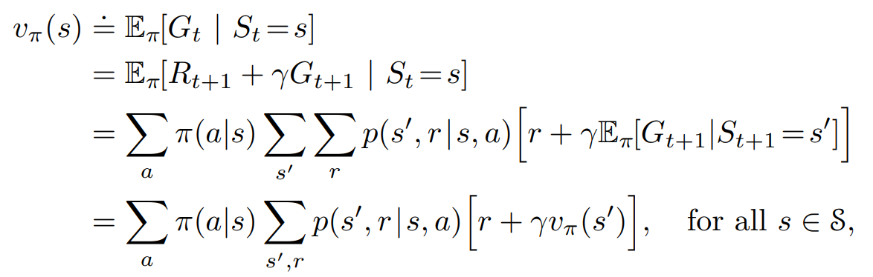
RL as Markov-Decision Process - Bellman equation
“relationship between the value of a state and the values of its successor states”

Slide 30
RL as Markov-Decision Process - Bellman equation
“relationship between the value of a state and the values of its successor states”

Slide 31
RL as Markov-Decision Process - Bellman equation
“relationship between the value of a state and the values of its successor states”

Slide 32
RL as Markov-Decision Process - Bellman equation
“relationship between the value of a state and the values of its successor states”

Slide 33
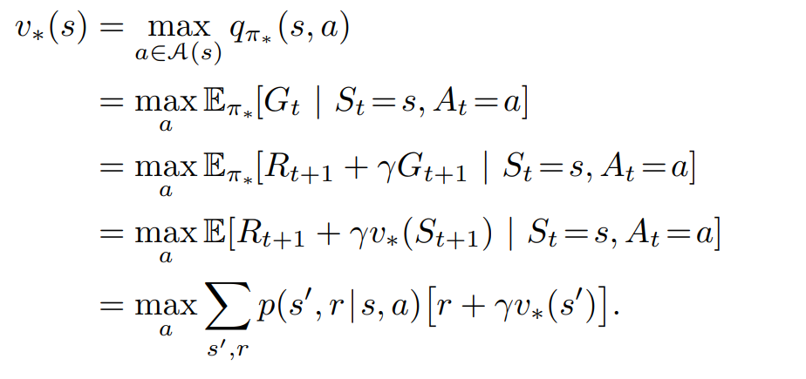
RL as Markov-Decision Process - Bellman optimality equation
Reminder: 𝜋* optimizes the expected return, so it always picks the best state/action indicated by v* / q*
Thus: We can find 𝜋* by finding v* or q*.
Bellman optimality equation for v*:

Slide 34
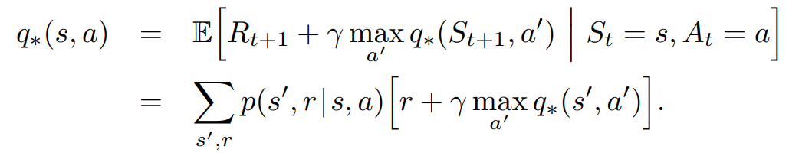
RL as Markov-Decision Process - Bellman optimality equation
Reminder: 𝜋* optimizes the expected return, so it picks the best state/action indicated by v* / q*
Thus: We can find 𝜋* by finding v* or q*.
Bellman optimality equation for q*:

Slide 35
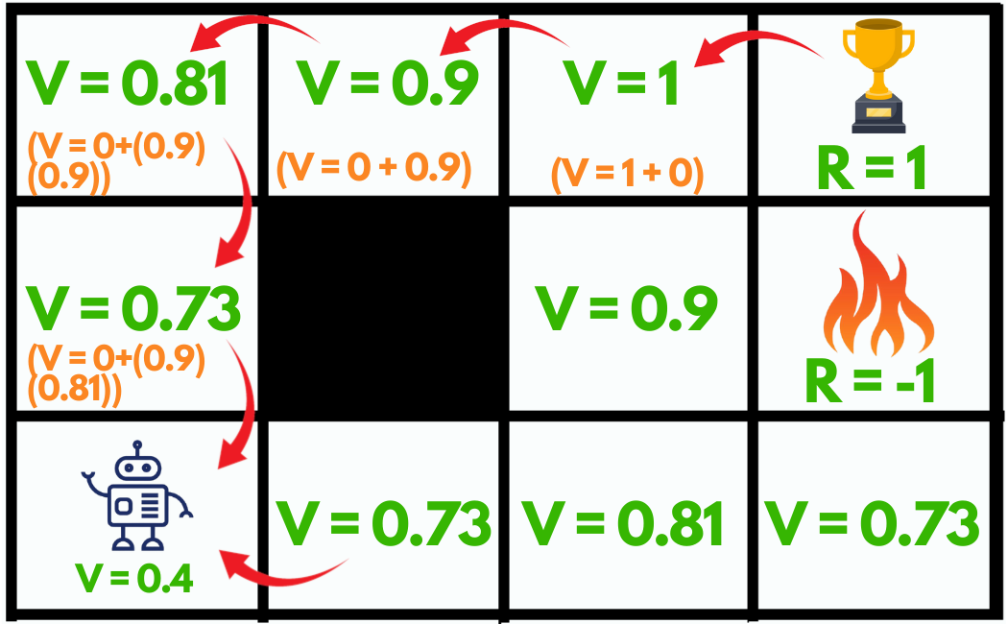
RL as Markov-Decision Process - Bellman equation
https://www.geeksforgeeks.org/bellman-equation/

Slide 36
RL as Markov-Decision Process - Bellman equation
Recap:
If we assume that we know probabilities of state transitions and that the environment is discrete, we can get calculate v_{𝜋}/q_{𝜋} .
https://www.geeksforgeeks.org/bellman-equation/

Slide 37
Dynamic Programming
Policy / Value Iteration

Slide 38
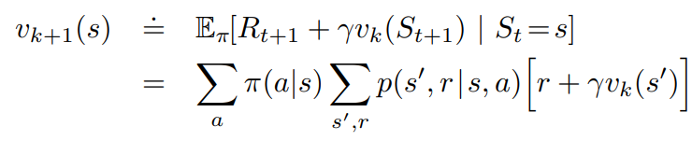
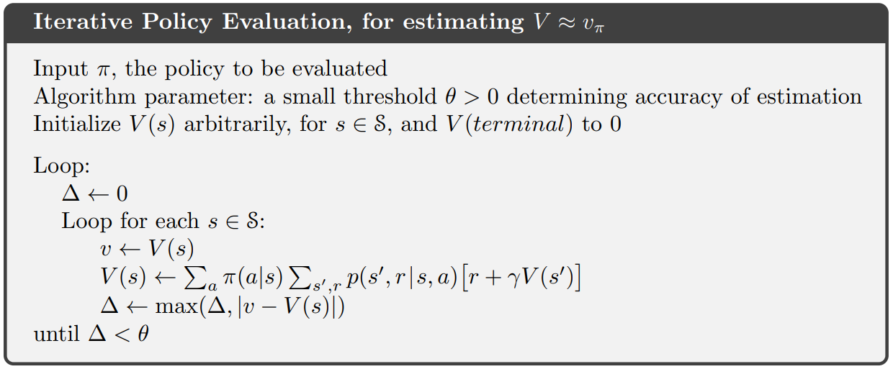
Dynamic Programming - Policy Evaluation
Dynamic Programming can be used to find optimal policies in an iterative process.
Policy Evaluation - approximation of v_{𝜋} by using Bellman equation as an update rule.
With each update as k ->∞, v_{k} -> v_{𝜋}

Slide 39
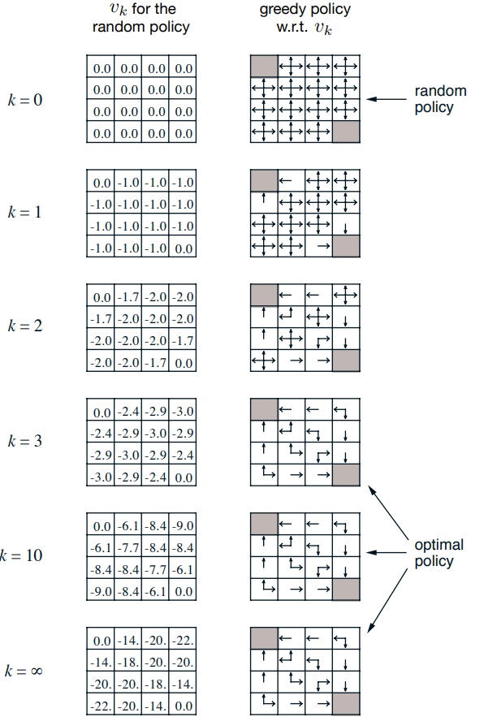
Dynamic Programming - Policy Iteration
Policy improvement theorem in short:
Get a random policy 𝜋
Get v_{𝜋}/q_{𝜋}.
Create a policy 𝜋’ that’s simply greedy to v_{𝜋} - it must as good as 𝜋 or better
Repeat that until 𝜋’ = 𝜋, which means we got 𝜋*
Notes:
W wielkim skrócie - pozwala nam wyznaczając q_{𝜋}znaleźć optymalną strategię startując z losowej.
Gdy znajdziemy wartości strategii,

Slide 40
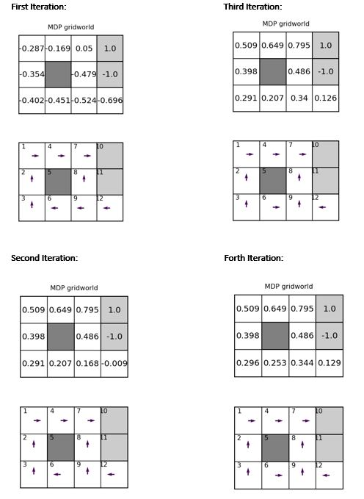
Dynamic Programming - Policy Iteration

Slide 41
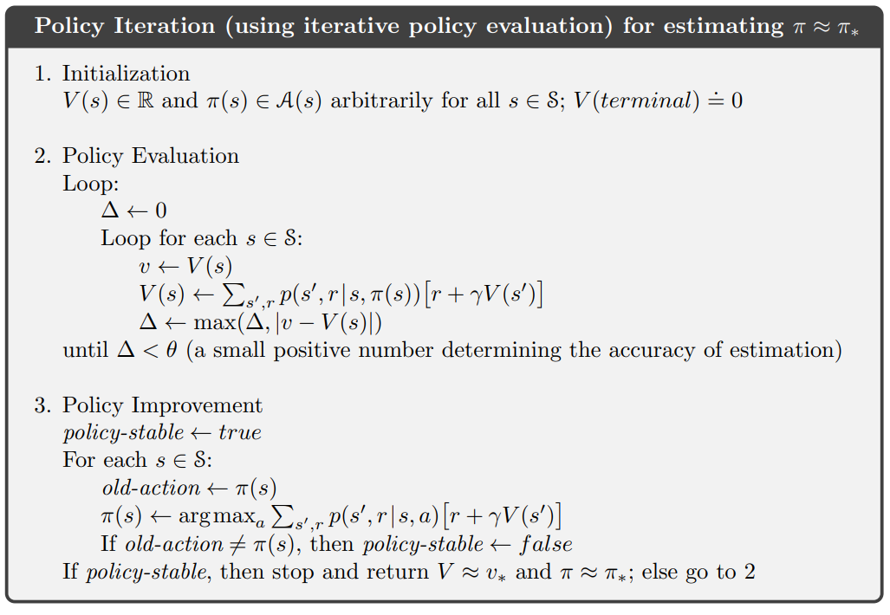
Dynamic Programming - Policy Iteration

Slide 42
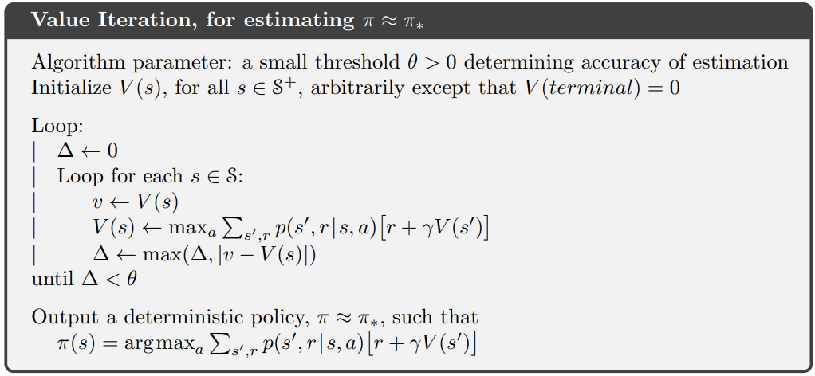
Dynamic Programming - Value Iteration
Policy Iteration is still not computationally effective - Policy Evaluation ends only with time limit.
Value Iteration is a special case of Policy Iteration, where Policy Evaluation is stopped after just one step - notice that update is Bellman Optimality Equation
Policy improvement step in contained within the max_{a}
Notes:
Page 105 - This algorithm is called value iteration. It can be written as a particularly simple update operation that combines the policy improvement and truncated policy evaluation steps
So the policy evaluation is just hidden within the max a (which is exactly the same as being greedy)

Slide 43
Dynamic Programming - Value Iteration
We can change the update, from Bellman Equation to Bellman Optimality Equation to get v*.
Policy improvement step in contained within the max_{a}
Notes:
Page 105 - This algorithm is called value iteration. It can be written as a particularly simple update operation that combines the policy improvement and truncated policy evaluation steps
So the policy evaluation is just hidden within the max a (which is exactly the same as being greedy)

Slide 44
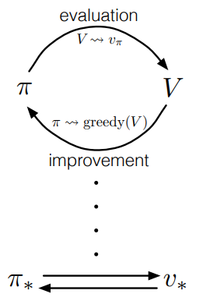
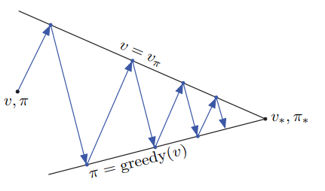
Dynamic Programming - Generalized Policy Iteration

Slide 45
Dynamic Programming
The problem:
Requires a complete model of the environment, including the transition probabilities and rewards for all state-action pairs.

Slide 46
Model-free approaches
TD-learning, Policy Gradient methods

Slide 47
Model-free approaches
Where learning finally comes in.
The exact model of the environment isn’t available most of the time.
Model-free methods aim to learn from experience only.
Instead of modeling the environment and solving equations, we’ll interact with it.

Slide 48
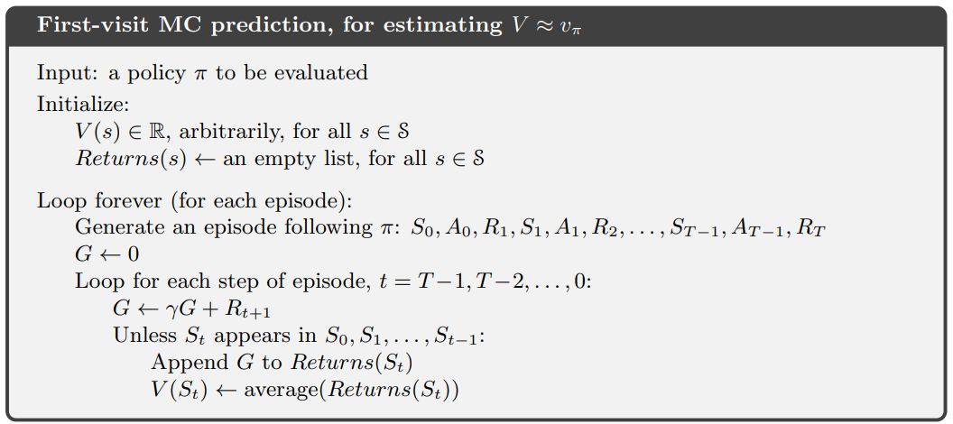
Model-free approaches - Monte Carlo
Most basic - Monte Carlo methods - estimates this directly - by averaging returns.
v(st) = v(st) + α [Gt - v(st)] - this will converge to v_{𝜋}
Simply play out many episodes to get trajectories and calculate the returns.

Slide 49
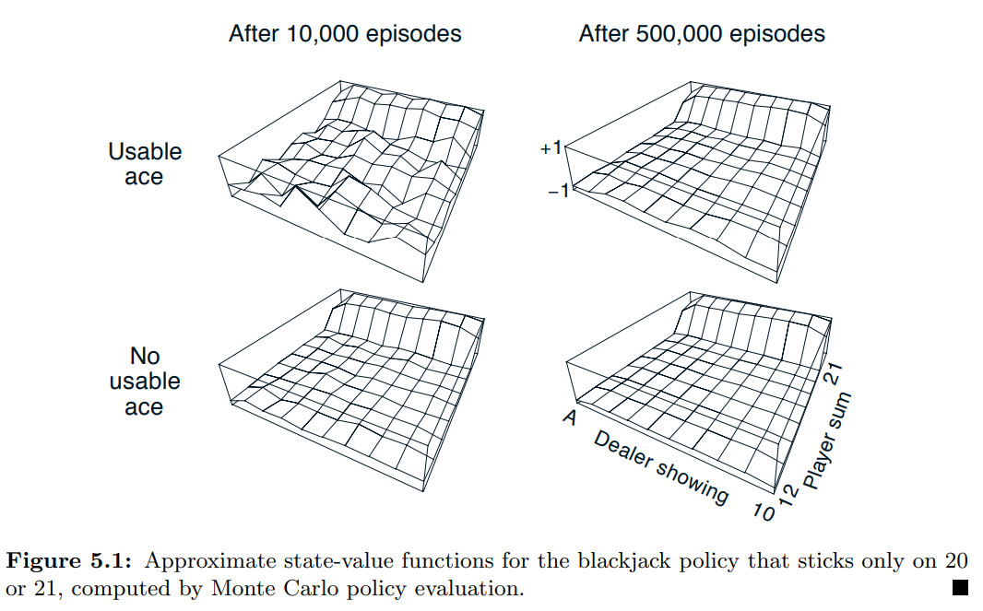
Model-free approaches - Monte Carlo

Slide 50
Model-free approaches - TD-Learning
While Monte Carlo seems promising, since it needs returns, a whole episode has to be played out, before an update can be done.
Temporal-Difference (TD) learning combines ideas from Dynamic Programming with learning from experience of Monte Carlo methods.
V(s_{t}) = V(s_{t}) + α [R_{t+1}+ γV(s_{t+1}) - V(s_{t})]

Slide 51
Model-free approaches - TD-Learning
While Monte Carlo seems promising, since it needs returns, a whole episode has to be played out, before an update can be done.
Temporal-Difference (TD) Learning combines ideas from Dynamic Programming with learning from experience of Monte Carlo methods.
V(s_{t}) = V(s_{t}) + α [R_{t+1}+ γV(s_{t+1}) - V(s_{t})]
Can be seen as an error - often called TD-error.
It’s an estimate of the difference between the estimated value of s_{t} and the better estimate R_{t+1} + V (s_{t+1})

Slide 52
Model-free approaches - TD-Learning
While Monte Carlo seems promising, since it needs returns, a whole episode has to be played out, before an update can be done.
Temporal-Difference (TD) Learning combines ideas from Dynamic Programming with learning from experience of Monte Carlo methods.
V(s_{t}) = V(s_{t}) + α [R_{t+1}+ γV(s_{t+1}) - V(s_{t})]
Can be seen as an error - often called TD-error.
It’s an estimate of the difference between the estimated value of s_{t} and the better estimate R_{t+1} + V (s_{t+1})
Practically the same as Monte Carlo - but instead of Gt we look at V(s_{t+1})

Slide 53
Model-free approaches - TD-Learning
While Monte Carlo seems promising, since it needs returns, a whole episode has to be played out, before an update can be done.
Temporal-Difference (TD) Learning combines ideas from Dynamic Programming with learning from experience of Monte Carlo methods.
V(s_{t}) = V(s_{t}) + α [R_{t+1}+ γV(s_{t+1}) - V(s_{t})]
Can be seen as an error - often called TD-error.
It’s an estimate of the difference between the estimated value of s_{t} and the better estimate R_{t+1} + V (s_{t+1})
Practically the same as Monte Carlo - but instead of Gt we look at V(s_{t+1})
“If one had to identify one idea as central and novel to reinforcement learning, it would undoubtedly be temporal-difference (TD) learning.”

Slide 54
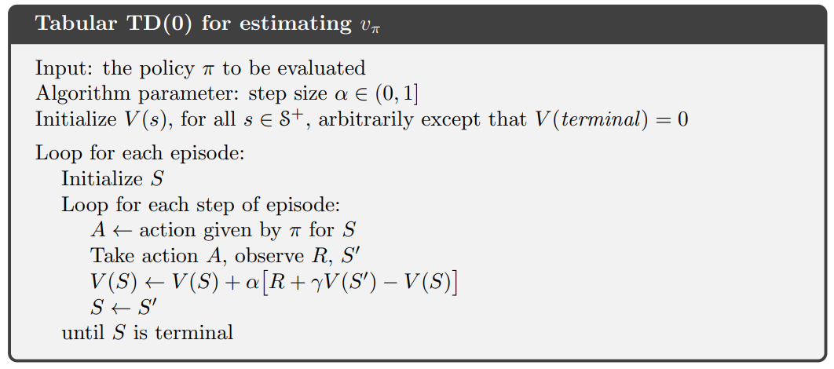
Model-free approaches - TD-Learning

Slide 55
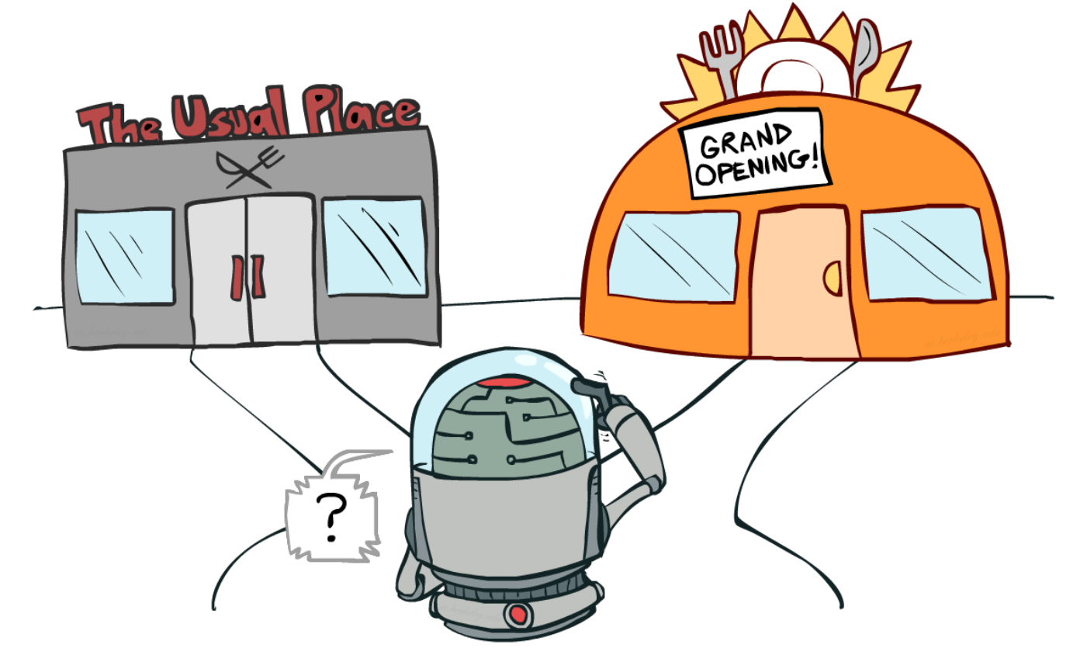
Model-free approaches - TD-Learning
Just like with Value Iteration, we could apply Generalized Policy Iteration to TD-learning to repeatedly get state values and create a policy that’s greedy.
However - since we’re not sweeping over all states and sampling them with our policy instead - there’s a new type of problem - exploration vs. exploitation.
UC Berkeley AI Course

Slide 56
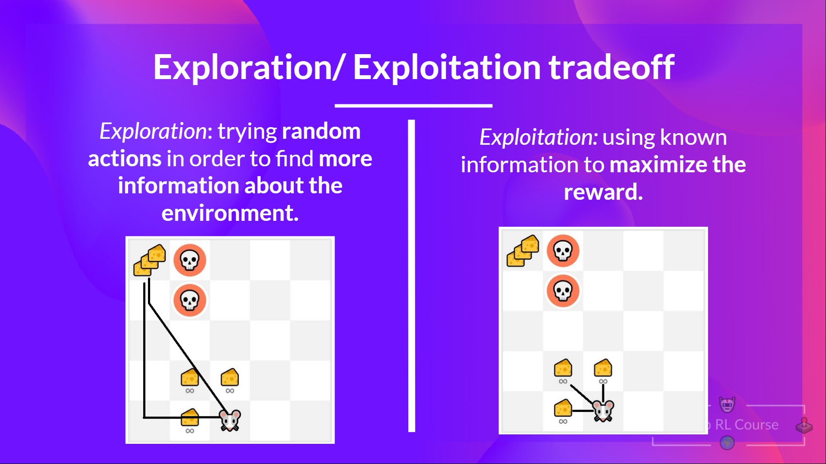
Exploration vs. Exploitation
It’s a common challenge in all of Reinforcement Learning - not just TD.
HuggingFace Deep RL Course

Slide 57
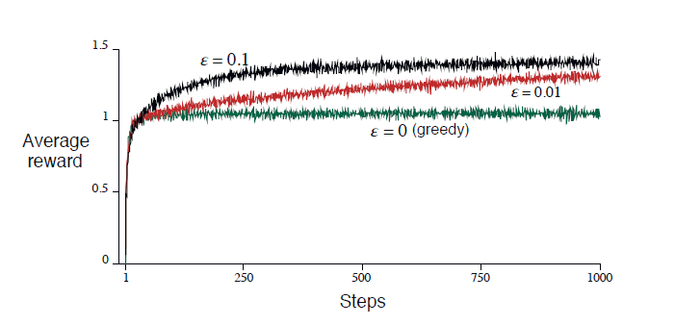
Exploration vs. Exploitation
Easiest and most common approach - ε-greedy
The policy is still greedy, but with ε-chance we take a random action.

Slide 58
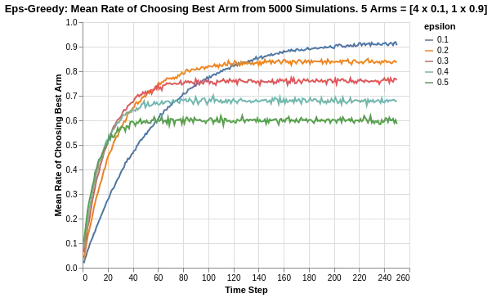
Exploration vs. Exploitation
A policy that sometimes takes random actions can’t be optimal, so epsilon is often lowered over time.
Multi-Armed Bandit Analysis of Epsilon Greedy Algorithm

Slide 59
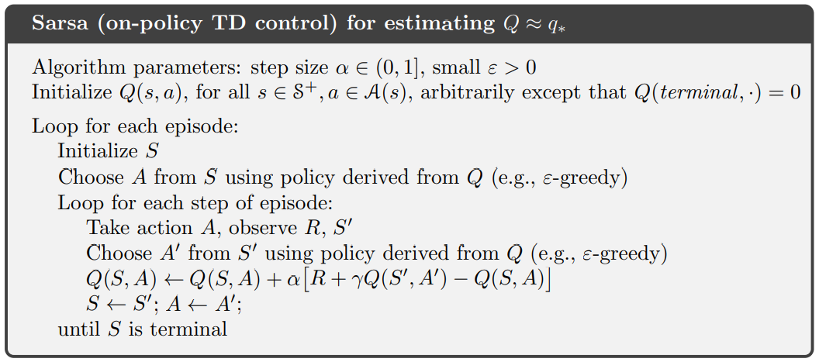
SARSA
One of the algorithms that combines Generalized Policy Iteration with TD-learning.
Like Value Iteration, SARSA updates it’s value function - but with each step, not episode.

Slide 60
SARSA
Notice that SARSA uses the same policy that it updates - an On-Policy approach.
However we know that it’s not an optimal one (since it explores).

Slide 61
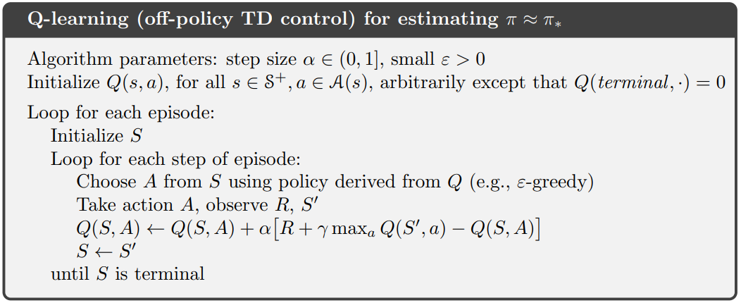
Q-Learning
Simple modification to SARSA - updating with regards to the greedy policy.
Q-learning has been shown to to converge with probability 1 to q*.
Off-policy approach - we’re updating with a different policy than we’re following.

Slide 62
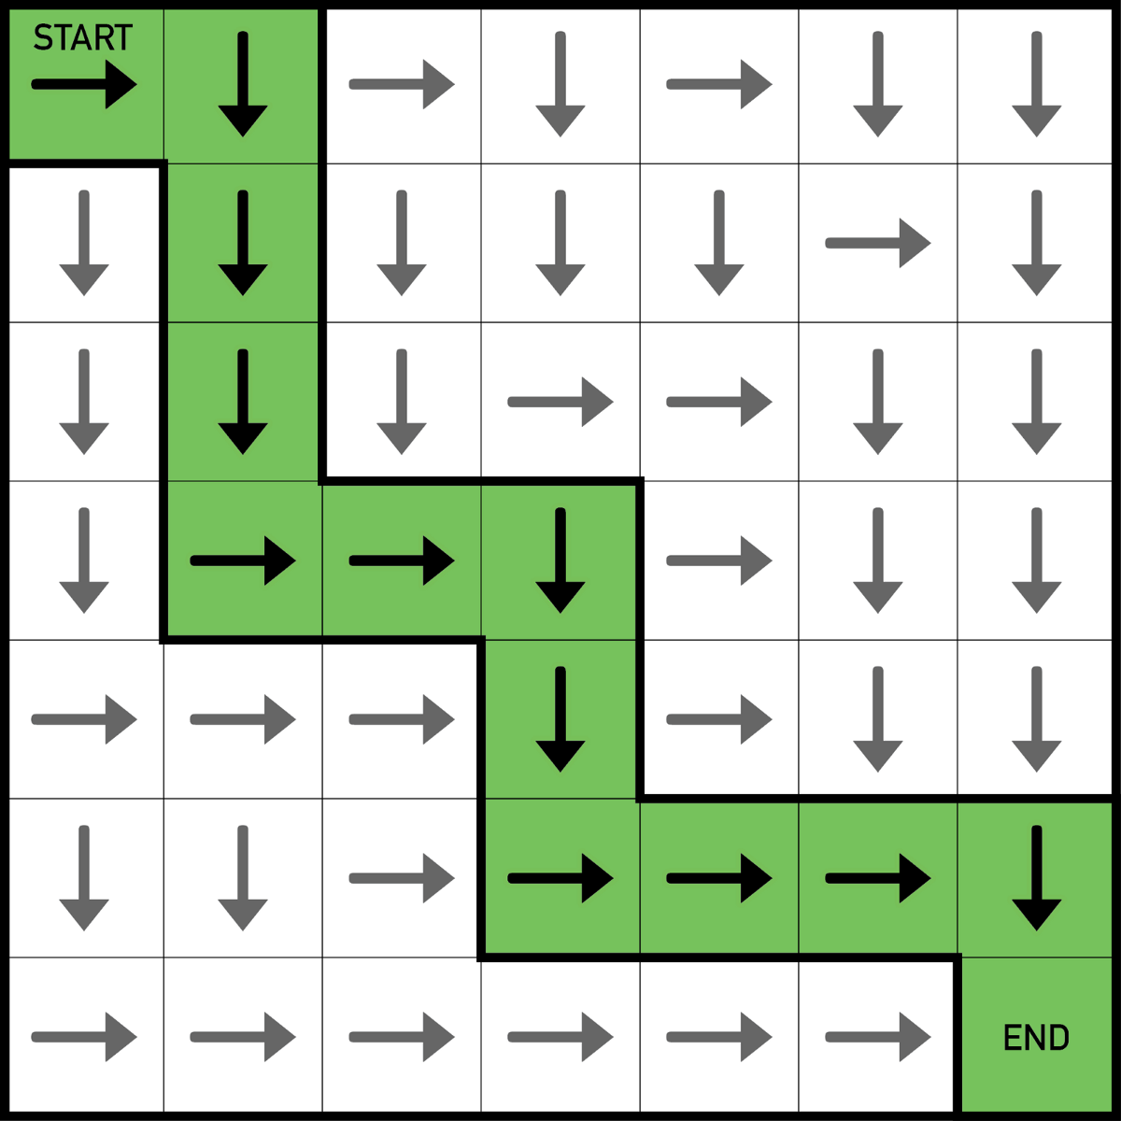
Tabular representation
It’s all great, but we still have the assumption of keeping state-action values in a table.
We can still directly apply it to some problems.
But most of the time state space is either too big or continuous.
Training an Agent to beat Grid World

Slide 63
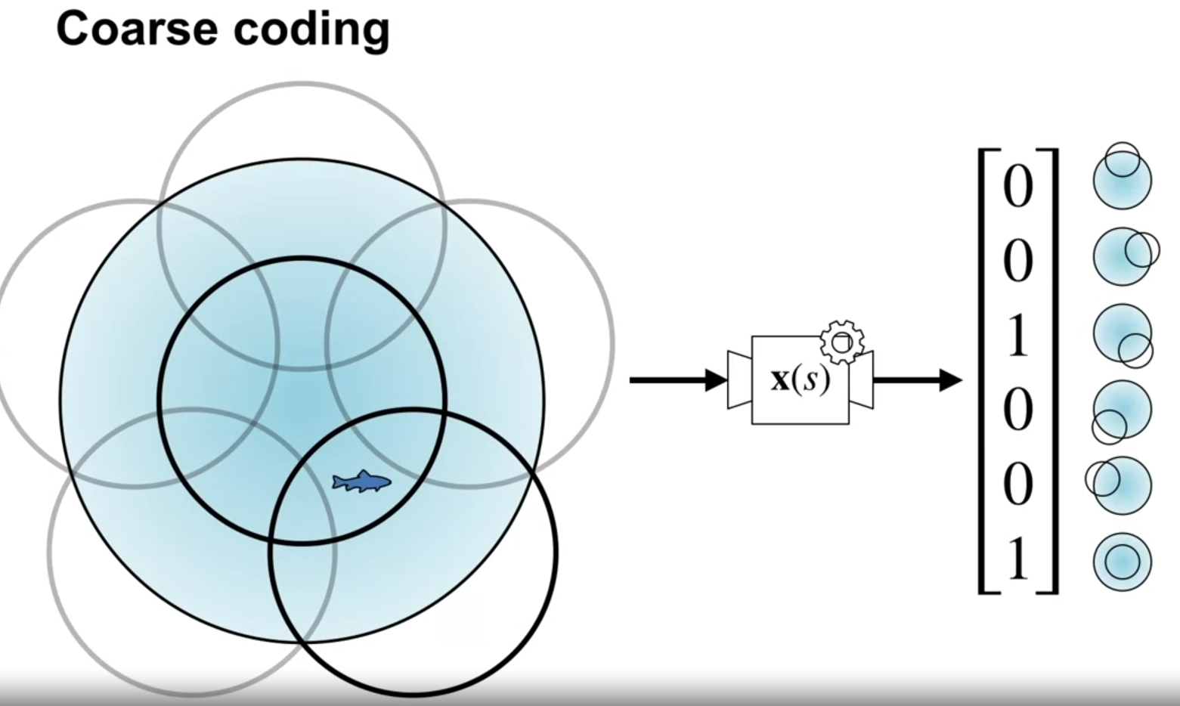
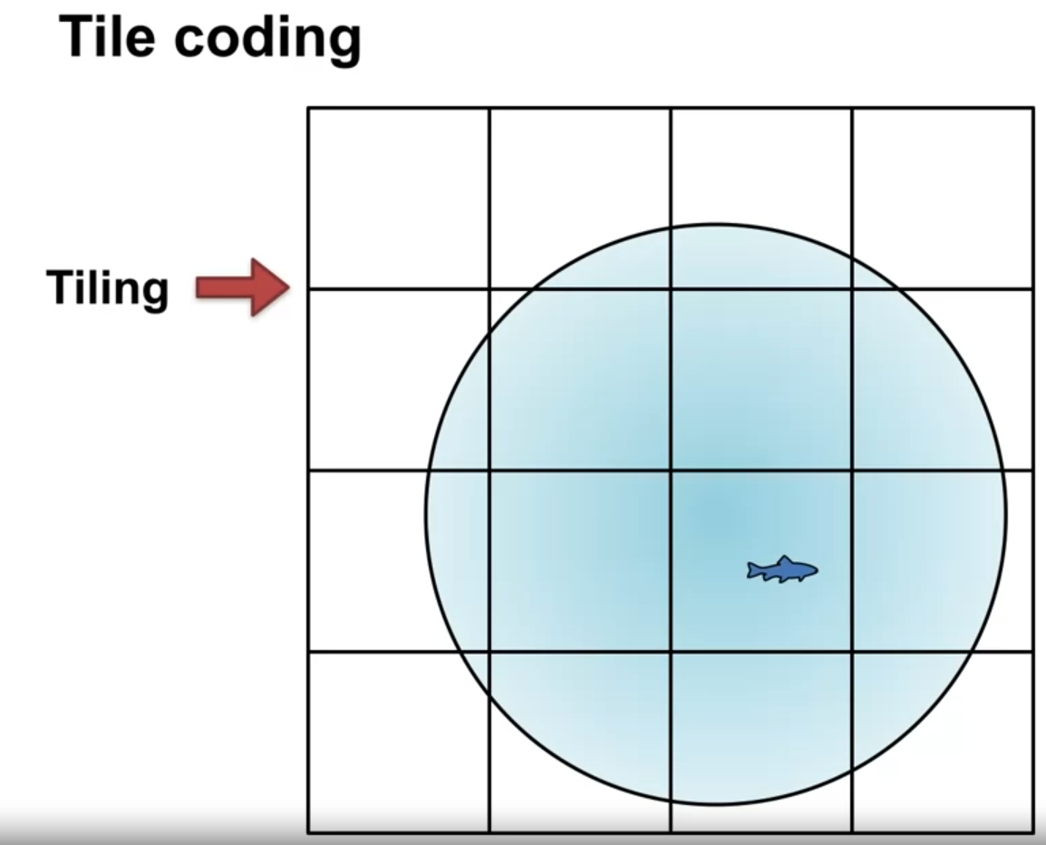
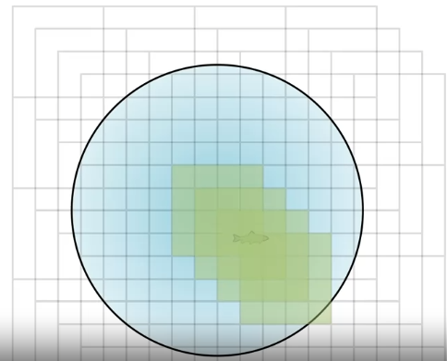

Discretization, state aggregation
We can easily map continuous spaces to discrete ones.
Similarly, we can aggregate huge discrete states into smaller ones.
Aggregatedstates
Original states

Slide 64
Q-Learning - Approximation, Deep RL
Since it’s practically feature engineering - a much better solution is to instead use approximation
We can approximate v_{𝜋}(s) or q_{𝜋}(s,a) with a function approximator - e.g. linear function or a neural network.
v_{w}(s) = v̂(s; w) ≈ v_{𝜋}(s)
q_{w}(s,a) = q̂(s,a; w) ≈ q_{𝜋}(s,a)
But what should the loss function be?
w = w + α (v_{𝜋}(s) - v̂(s; w)) ∇v̂(s; w)

Slide 65
Q-Learning - Approximation, Deep RL
But what should the loss function be?
w = w + α (v_{𝜋}(s) - v̂(s; w)) ∇v̂(s; w)
Don’t have access to v_{𝜋}(s), but if we look back at TD-Learning:
V(s_{t}) = V(s_{t}) + α [R_{t+1}+ γV(s_{t+1}) - V(s_{t})]
We can use the same methodology here
w = w + α (R_{t+1}+ γv̂(s_{t+1}) - v̂(s_{t}; w)) ∇v̂(s_{t}; w)

Slide 66



Q-Learning - Approximation, Deep RL
This is exactly what DQN does.
+ few simple trick:
Skipping frames
Experience replay
Reward clipping
Fixed target network
DeepMind Atari DQN

Slide 67

Policy Gradient Methods
Learning the policy directly
Introduction to Reinforcement Learning Policy Gradient

Slide 68

Policy Gradient Methods
What if instead of training a neural network to predict state values, we predict actions directly instead?
Policy Gradient methods seek to learn 𝜋(a_{t} | s_{t}) directly, omitting value functions.
Deep Reinforcement Learning: Pong from Pixels

Slide 69


Policy Gradient Methods
Objective: Learn weights θ for 𝜋(a | s,θ) = P(A_{t}=a | S_{t}=s, θ_{t}=θ)
Gradient ascent: θ_{t+1} = θ_{t} + α ∇ J(θ_{t})
J - the objective function, in RL is maximizing the return
REINFORCE - Uses Monte Carlo approach as before, play out episodes and average the returns.

Slide 70

Policy Gradient Methods - REINFORCE
Pros over DQN:
Messy world: In some environments, Q functions might be too complex to learn.
Speed: Faster convergence
Stochastic Policies: DQN learns deterministic only.
Continuous Actions: Naturally models continuous action space. (probability distribution)
Cons over DQN:
Data inefficient: Needs more data
Stability: Less stable training.
Awarding actions: Calculating rewards at the end - all actions are averaged as good/bad depending on the reward.
Deep Reinforcement Learning: Pong from Pixels

Slide 71
Advantage Actor-Critic (A2C)

Slide 72

Advantage Actor-Critic (A2C)
Combines TD-Learning with REINFORCE
To learn the policy (“actor”), instead of averaging returns Gt (Monte Carlo), we approximate the value function q_{𝜋} (“critic”) the same way as we did before in TD-Learning.

Slide 73

Model-based approaches
Similar techniques and approaches.
Main difference is that through having the model, they can use planning - “playing out” their actions and seeing which lead to the best future states.

Slide 74

AlphaZero
Monte Carlo tree search (MCTS) to guide its search for the best moves.
Neural network to estimate values of a board under the policies from policy network
The policy network, to predict the action that is most likely to lead to the best outcome in a given state.
DeepMind’s AlphaZero beats state-of-the-art chess and shogi game engines

Slide 75

Other examples
Policy Gradient Enhancement
ChatGPT

Slide 76

Learning Agile Locomotion For Quadruped Robots
Policy Gradient based

Slide 77

Learning Agile Locomotion For Quadruped Robots
Actor-Critic version

Slide 78
Questions
&
Discussion

Slide 79
Thank you!
See you next week on ML Implementation.

